Slide 1
DESIGN AND SIMULATION OF AI-DRIVEN EARLY DETECTION OF DIGITAL BURNOUT AND OCCUPATIONAL STRESS
By:
ADEOYE AISHAT OLUWATOBI (2022/40906)
Supervised by DR. L.O OMOTOSHO
OSUN STATE UNIVERSITY, OSOGBO
DEPARTMENT OF COMPUTER SCIENCE

Slide 2
PRESENTATION OUTLINE
Introduction
Motivation of study
Statement of research problem
Research questions
Aim and objectives
Scope of study
Literature review
Methodology
Expected contribution to knowledge
Conclusion
Research timeline
References

Slide 3
INTRODUCTION
Modern workflows have shifted heavily toward digital tools. However, prolonged use frequently leads to cognitive exhaustion, which is often mistaken for high productivity. If ignored, this exhaustion gradually builds into severe mental fatigue and burnout.
To solve this, we need a digital system capable of measuring the slightest cognitive decline in human interaction.

Slide 4
MOTIVATION OF STUDY
Drastic workforce shift
Prologued device usage
Hidden cognitive decline
Expensive diagnostics

Slide 5
STATEMENT OF RESEARCH PROBLEM
Heavy dependency on physiological data
Lack of passive privacy preserved system

Slide 6
RESEARCH QUESTIONS
How can Artificial Intelligence (AI) be used to detect early sign of occupational stress and digital burnout?
If Artificial Intelligence (AI) can be used to detect the early sign of occupational stress and digital burnout, which machine learning techniques are most suitable for implementing such detection system?

Slide 7
AIM AND OBJECTIVES
AIM: The aim of this project is to design and implement an Artificial Intelligence (AI) system for early detection of digital burnout and occupational stress.
OBJECTIVES: To achieve this aim, the specific objectives are:
Collection of secondary behavioral data.
Filter and preprocessing of collected data.
Simulation and testing the designed model.
Evaluation of the model.

Slide 8
SCOPE OF THE STUDY
The scope of this project is restricted to utilizing passive behavioral data specifically keystroke latency and cursor velocity to simulate cognitive fatigue and determine whether the Isolation Forest or the One-Class Support Vector Machine provides optimal anomaly detection.

Slide 9
LITERATURE 1 OF 3
Killourhy, K. S., & Maxion, R. A. (2009): Comparing Anomaly-Detection Algorithms for Keystroke Dynamics.
Problem Addressed: Identifying the most mathematically effective anomaly detection algorithms for continuous behavioral tracking.
Method Used: A comparative evaluation of multiple unsupervised anomaly detectors including Support Vector Machines (SVM) on a standardized keystroke dataset.
Result: Proved that unsupervised anomaly detection models can establish highly accurate, individualized behavioral baselines.
Comment: This foundational study validated the strict mathematical efficacy of anomaly detection for keystrokes. However, it applied the architecture strictly to cybersecurity and continuous authentication. This project directly adapts these exact mathematical architectures to solve the problem of digital burnout.

Slide 10
LITERATURE 2 OF 3
Banerjee, S., Arjunan, S. P., & Kumar, G. (2022): Keystroke Dynamics Based Cognitive Workload Modeling.
Problem Addressed: The need to correlate digital interaction patterns with cognitive stress and workload.
Method Used: Supervised machine learning techniques analyzing keystroke timing data.
Result: The study confirmed that keystroke interaction patterns strongly correlate with human cognitive load.
Comment: Because the solution relied entirely on Supervised Learning, it requires heavily labeled stress data to function. This is often unattainable in real-world corporate environments, proving the necessity for the unsupervised approach proposed in this project.

Slide 11
LITERATURE 3 OF 3
Ciabattoni, L., Monteriù, A., & Pepa, L. (2020): Stress Detection in Computer Users From Keyboard and Mouse Dynamics.
Problem Addressed: The challenge of detecting stress unobtrusively without attaching intrusive physical sensors to a user's body.
Method Used: Collected keyboard and mouse data "in-the-wild" and applied a Random Forest machine learning classification model.
Result: Successfully classified stress levels using only standard computer peripherals (76% accuracy for keyboard, 63% for mouse).
Comment: While this proves physical wearables are unnecessary, the study relied on actively inducing stress through forced tests rather than passively monitoring naturalistic work. This leaves a critical gap for the passive, background anomaly detection utilized in this project.

Slide 12
METHODOLOGY 1 OF 4
Collection of secondary behavioral data:
Secondary data is obtained from the UEBA Dataset [Martin et al., 2020]. (figure 1)
The data set includes information on user flight time and mouse movement.
The dataset will be used to train algorithm without requiring active monitoring.

Slide 13
METHODOLOGY 2 OF 4
2. Filter and preprocessing of collected data:
The raw data collected is filtered to isolate flight time and mouse movement.
Python panda is used to filter and preprocess the collected dataset.

Slide 14
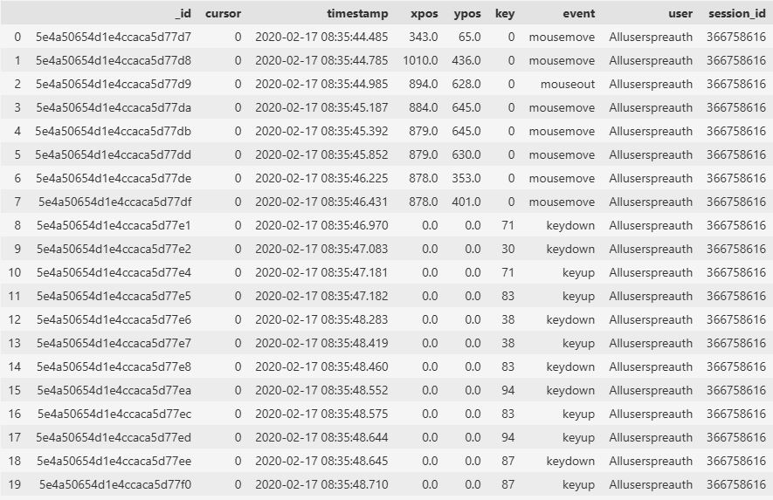
METHODOLOGY 3 OF 4
Figure 1: Secondary dataset obtained from the UEBA Dataset

Slide 15
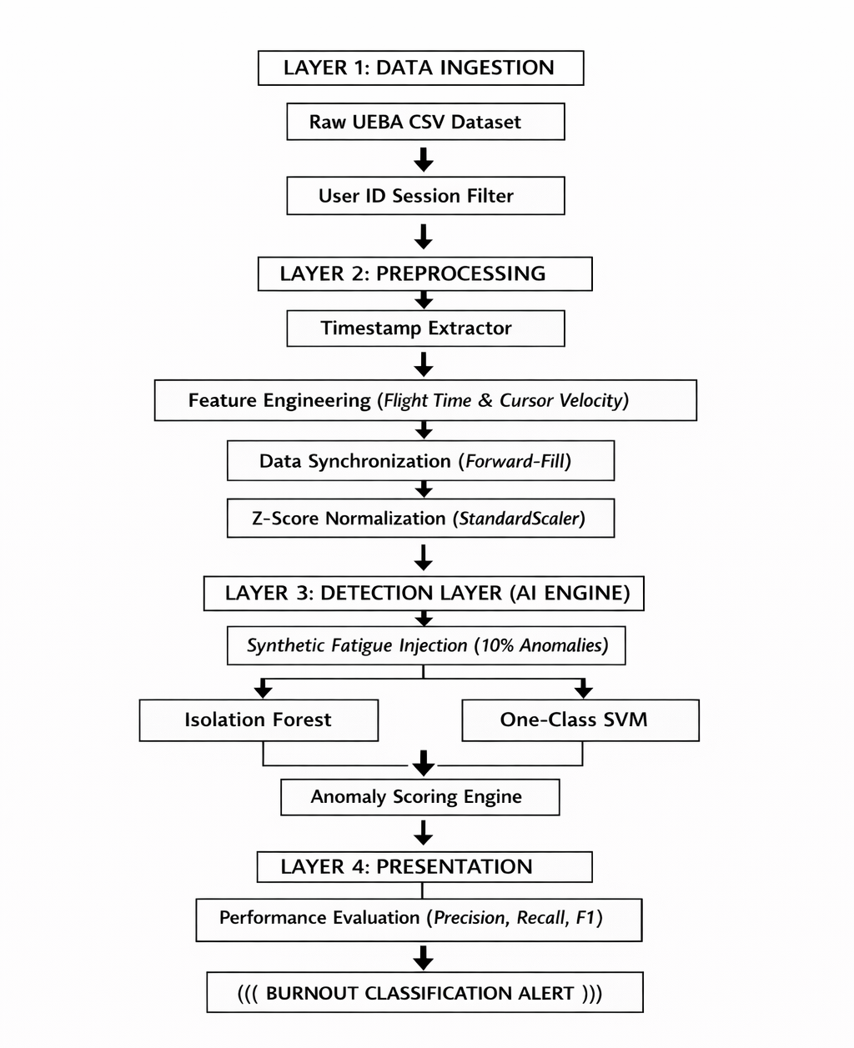
METHODOLOGY 4 OF 4
Figure 2: Flowchart of the project simulatoin

Slide 16
EXPECTED CONTRIBUTION TO KNOWLEDGE
This research contributed to the existing knowledge through:
Detecting stress and burnout using passive behavioural data.
Measuring early cognitive fatigue without expensive diagnostics.
Applying unsupervised machine learning model to detect each users anomaly behaviour.

Slide 17
CONCLUSION
In conclusion, this study successfully engineered a passive, software-only framework capable of detecting early-stage digital burnout. By validating unsupervised anomaly detection models specifically the Isolation Forest and OC-SVM the research proved that cognitive decline can be accurately classified using only standard computer peripherals. Ultimately, this system delivers a privacy-preserving, scalable blueprint for occupational health that completely eliminates the reliance on subjective surveys and intrusive biometric hardware.

Slide 18
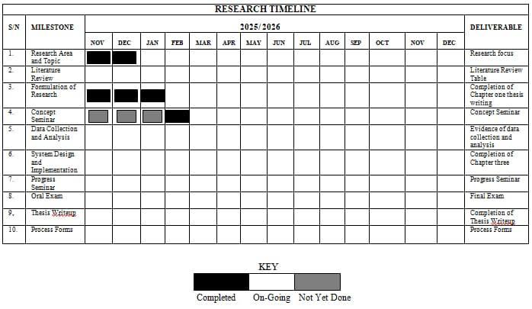

Slide 19
REFERENCES
Banerjee, S., Arjunan, S. P., & Kumar, G. (2022). Keystroke Dynamics Based Cognitive Workload Modeling. IEEE Transactions on Affective Computing, 13(4), 1889-1901.
Ciabattoni, L., Monteriù, A., & Pepa, L. (2020). Stress Detection in Computer Users From Keyboard and Mouse Dynamics. IEEE Transactions on Consumer Electronics, 66(4), 304-311. Killourhy, K. S., & Maxion, R. A. (2009). Comparing Anomaly-Detection Algorithms for Keystroke Dynamics. IEEE/IFIP International Conference on Dependable Systems & Networks, 125-134.
Killourhy, K. S., & Maxion, R. A. (2009). Comparing Anomaly-Detection Algorithms for Keystroke Dynamics. IEEE/IFIP International Conference on Dependable Systems & Networks, 125-134.

Slide 20
THANK YOU FOR LISTENING

